Slide 1
FEATURE SELECTION ALGORITHM
EKANSH GUPTA
L. S.VISHNU SAI RAO

Slide 2
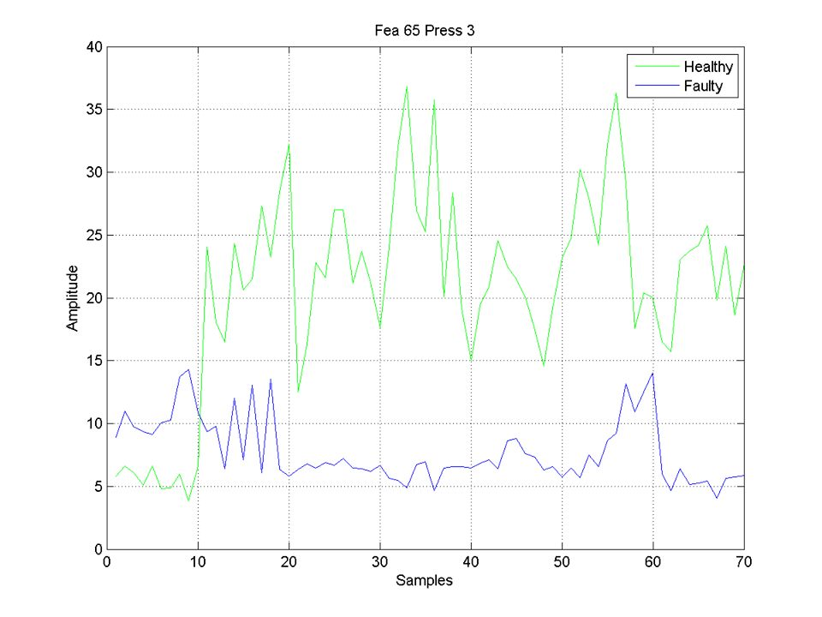
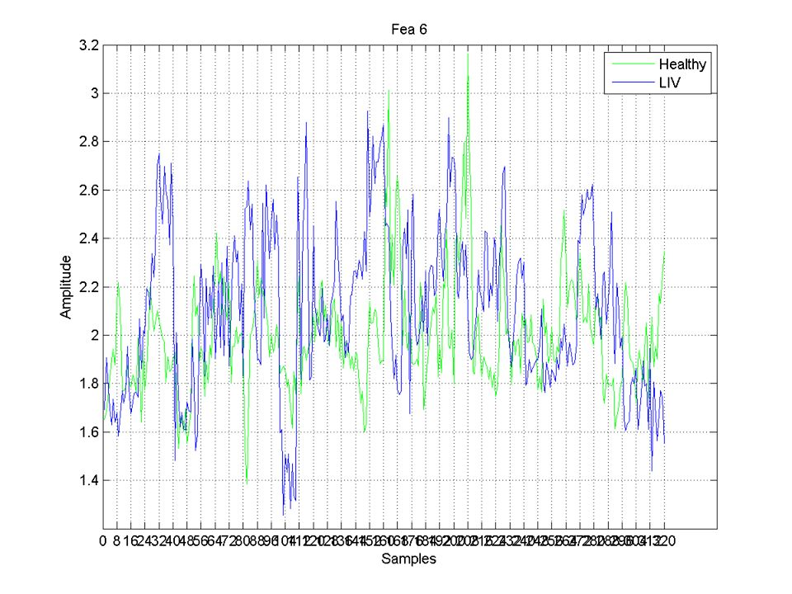
Good Features v/s Bad Features
A normal collection of plots has a lot of random graphs for features.
Out of these a good feature is defined to be the one which is
consistent for the healthy as well as the faulty plots.
A good feature can easily be visually distinguished from a bad feature. HAVE A LOOK….

Slide 3
Key Parameters For Good Features
The plots shall not intersect too much i.e. they must have minimum common values for all samples throughout the plot.
The individual plots shall not vary abnormally as from their average variation throughout the plot.
The plots shall be separable i.e. there shall be an imaginary line above which should mostly lie, without loss of generality, the healthy plot and below which, mostly the faulty plot.
The ratio of the mean values of the healthy and faulty plots (or vice versa) must be above a certain threshold. Its physical implication measures the amount of improbability a faulty feature has to resemble its healthy counterpart.

Slide 4
LETS HAVE A DEEPER LOOK
A GOOD FEATURE IS ONE WHICH…..

Slide 5
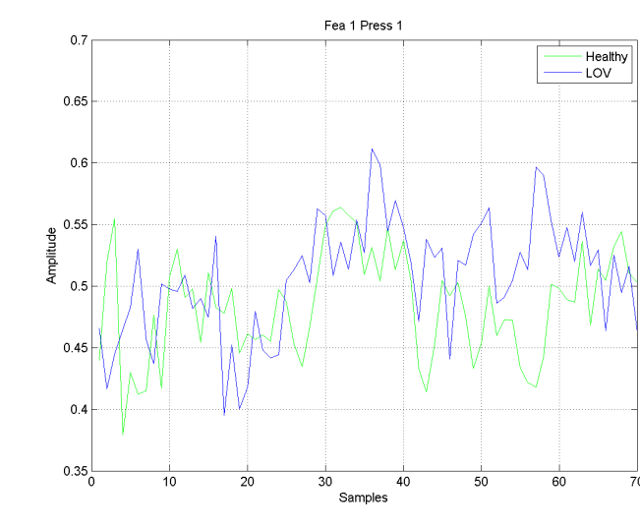
The plots should not intersect too much i.e. they must have minimum common values for all samples throughout the plot.
Good Feature Characteristics

Slide 6
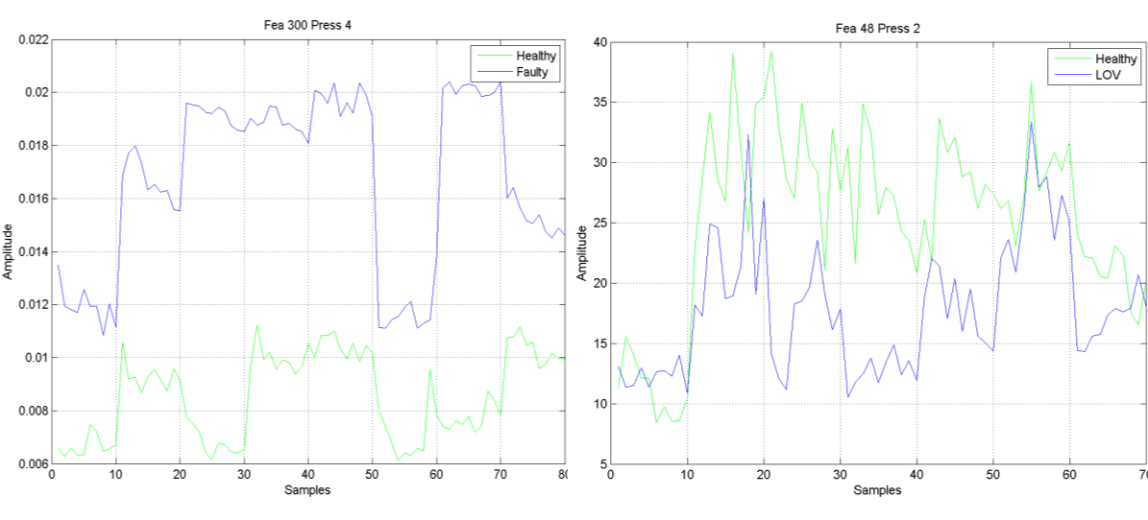
The plots should be separable i.e. there shall be an imaginary line above which should mostly lie, without loss of generality, the healthy plot and below which, mostly the faulty plot.
Good Feature Characteristics

Slide 7
The plots should have an effective mean ratio. The ratio of the mean values of the healthy and faulty plots (or vice versa) must be above a certain threshold. Its physical implication measures the amount of improbability a faulty feature has to resemble its healthy counterpart.
Good Feature Characteristics
LOW MEAN RATIO BETWEEN PLOTS

Slide 8
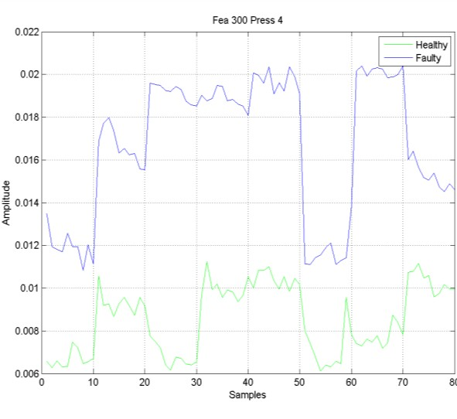
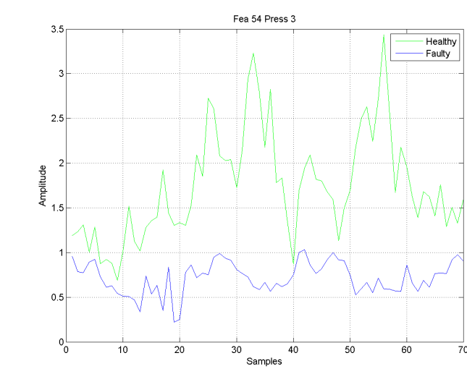
The individual plots should not vary abnormally as from their average variation throughout the plot.
Good Feature Characteristics
ABNORMAL VARIATION

Slide 9
Technical Terms Used In The Algorithm
This is the measure of how many times the plots in a feature intersect with each other. Mathematically, it is the number of times the difference of the two plots attains a value equal to zero.
ZCR (Zero Crossing Rate)
MEAN
This measures the mean ratio between a healthy and a faulty plot.
The greater this number, the better a feature is.
The higher the ZCR, the lesser good a feature is

Slide 10
Technical Terms Used In The Algorithm
This takes care of the abnormal variation in a feature. For a plot with the data is first standardized as:
STANDARD DEVIATION OF MEAN (STD)
SEPARATION
This measures a plot’s ability to have the two of its components (the healthy and the faulty one) separated by an imaginary line. The condition is as follows:
Let the plot with higher mean be called “M” and let the other be called “m”. The separation condition is true if:
Min (“M”) > Max (“m”)
The higher this value the lesser good a feature is.
is the standard deviation of the data. The mean of Z is calculated for every dataset. Let it be called Mi ( “i” ranges as number of datasets ) The standard deviation of mean is defined as

Slide 11
Scheme For Filtering Bad Characteristics
ZCR is used to keep a check on the number of intersections a feature has.
A mean ratio measuring variable is used to filter features that have low mean ratio.
A variable calculates the violations of the separation condition. This will filter features with considerably high number of violations.
To reject features with abnormal variations the standard deviation of mean is used

Slide 12
Point to be noted
The algorithm finds out the best features in a given data distribution, provided all the datasets are good. However if one of the dataset is corrupted, the algorithm tries to find those features which might have been rejected due to the wrong values in the corrupted dataset.
For this, a function rej_func() is defined that tries to find out a dataset, if at all, that might be adversely affecting the good features.
It returns the dataset that should be rejected. The algorithm then deletes the dataset from the data distribution and starts afresh.
This process can be used any number of times a user wishes making the rejections of more than 1 dataset possible. That is, the rej_func is used iteratively in the program for a total of “maxreject” number of times, a parameter to be provided by the user.

Slide 13
START
Are the rejected datasets equal to maximum rejections possible?
ALGORITHM OVERVIEW
no
Check if any dataset is to be rejected
yes
Delete the dataset
yes
no
Separation filter
Standard deviation filter
Pass the modified data to the filters
ZCR filter
Mean filter
END

Slide 14
RESULTS

Slide 15
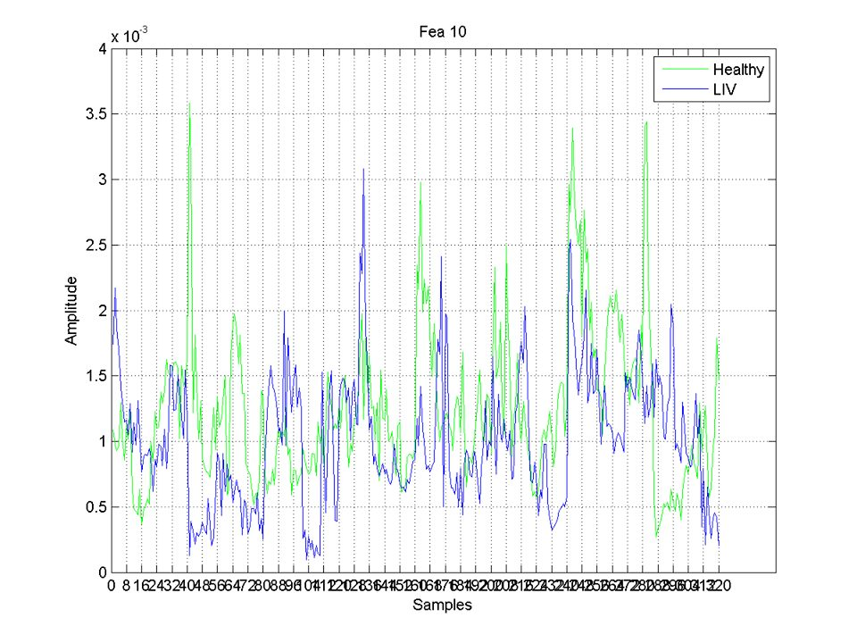
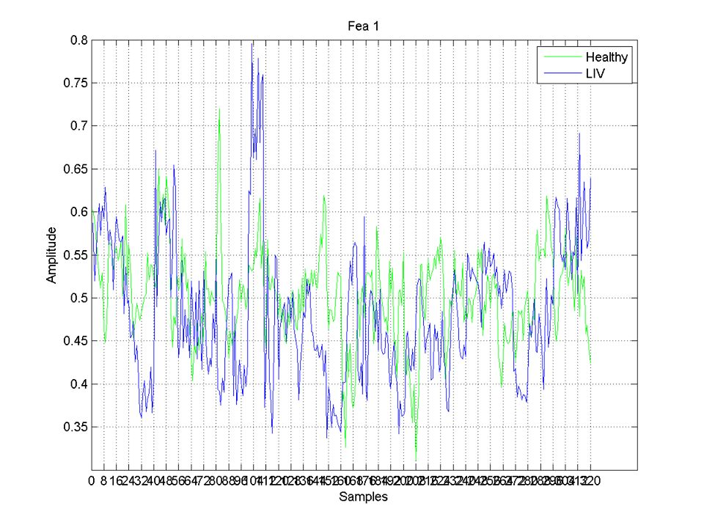
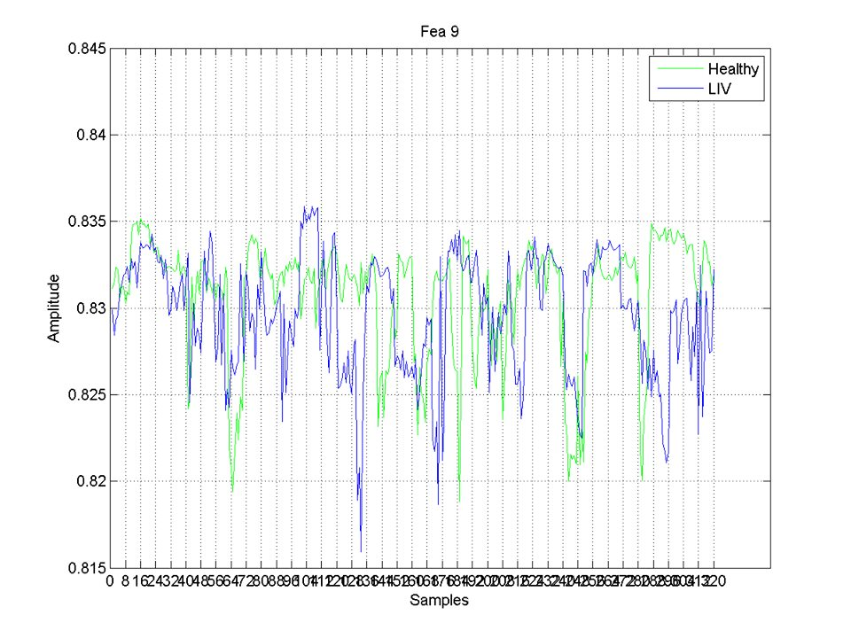
Features Judged As Bad

Slide 16
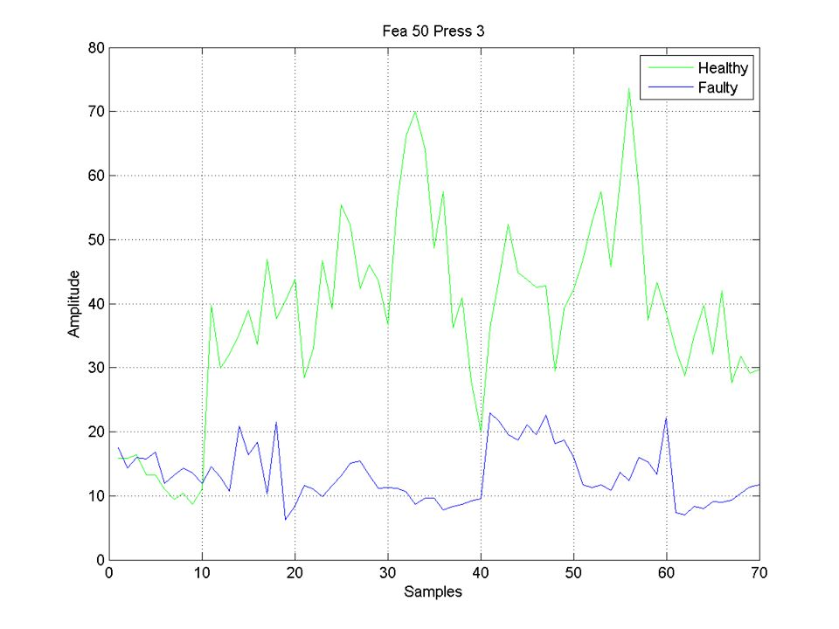
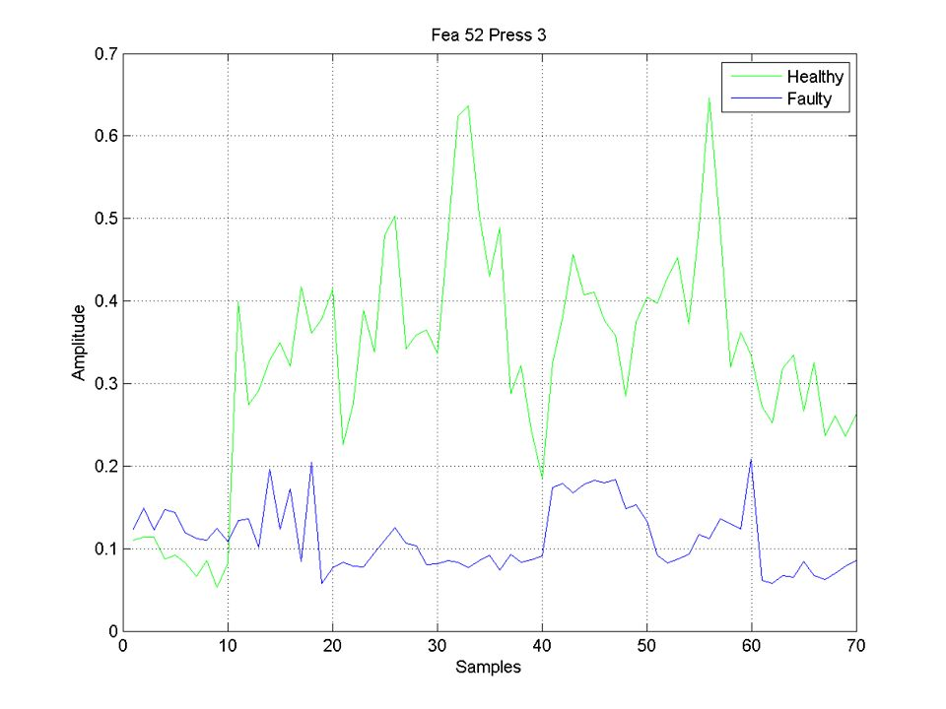
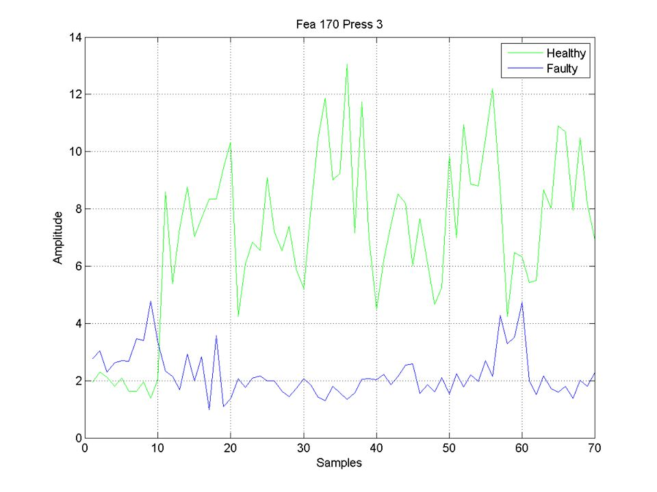
Features Judged As Good

Slide 17
THE END

